Slide 1
Advanced Image Processing Techniques for Medical Diagnostics in Brain Stroke Prediction.
PIP104 University Project-II
Review-1
Batch Number: 12
Roll Number | Student Name
20211CIT0052 | ERANTI SAI KISHAN
20211CIT0060 | MEGHANA.GS
20211CIT0049 | LAKKI REDDY VARSHITHA
20211CIT0052 | ERANTI SAI DINESH
Under the Supervision of,
Dr. / Mr. / Ms. Bhavya.B
Professor / Associate Professor / Assistant Professor
School of Computer Science & Engineering
Presidency University

Slide 2
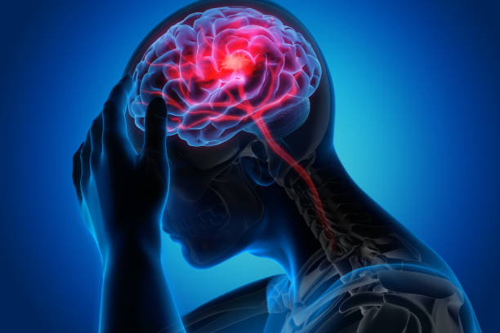
Introduction
Stroke's global impact: It is a leading cause of death and disability worldwide.
Importance of early detection: Early identification is crucial for effective stroke treatment and improving patient outcomes.
Challenges of traditional methods: Manual analysis of medical images like CT and MRI is time-consuming and prone to human error.
AI and ML in stroke detection: Advanced image processing techniques powered by artificial intelligence (AI), machine learning (ML), and deep learning enhance diagnostic accuracy and speed.
Convolutional neural networks (CNNs): CNNs are key to identifying subtle patterns in medical images that might be missed by human observers.
Multimodal image integration: Combining multiple imaging modalities (e.g., CT, MRI) improves the comprehensiveness of stroke diagnosis.
Real-time diagnosis: AI-based tools enable faster, real-time detection and diagnosis, which is vital for timely medical interventions.
Improving patient outcomes: These technologies contribute to more accurate and timely treatment, significantly improving recovery and survival rates.
Transforming stroke diagnostics: AI, ML, and deep learning are reshaping how strokes are detected and predicted in clinical settings.

Slide 3
Literature Review
SLNO | TITLE OF THE PAPER AND THE YEAR | AUTHOR | JOURNAL | METHODOLOGY | ADVANTAGE
1 | Stroke Prediction Using Deep Learning and Transfer Learning Approache | Ting-Wei Wu | Taiwan National Science and Technology Council | Category imbalance treatment and deep learning method. | Achieved a 71.6% accuracy and a 19.1% false-negative rate
2 | An Improved Concatenation of Deep Learning Models for Predicting and Interpreting Ischemic Stroke | Nurul Halimatul Asmak Ismail | Deputyship for Research and Innovation, Ministry of Education, Saudi Arabia | a convolutional neural network and a long short-term memory, logistic regression, random forest, extreme gradient boosting, k-nearest neighbor, artificial neural network, long short-term memory, and convolutional neural network | 95.9% accuracy
3 | Automated Ischemic Stroke Subtyping Based on Machine Learning Approach | Gang Fang | National Science Foundation of China | C, Random-Forest-Classifier, Extra-Trees-Classifier, AdaBoost-Classifier, and Multinomial-Naïve-Bayes-Classifier as estimator respectivelY
4 | Automated Stroke Prediction Using Machine Learning: An Explainable and Exploratory Study With a Web Application for Early Intervention | Jungpil Shin | Competitive Research Fund of The University of Aizu, Japan | SHAP (Shapley Additive Explanations) and LIME (Local Interpretable Model-agnostic Explanations) | 83-91% accuracy

Slide 4
Cont..
SLNO | TITLE OF THE PAPER AND THE YEAR | AUTHOR | JOURNAL | METHODOLOGY | ADVANTAGE
5 | A Review on Computer Aided Diagnosis of Acute Brain Stroke | Mahesh Anil Inamdar UdupiRaghavendra Anjan Gudigar Yashas Chakole Ajay Hegde Girish R. Menon Prabal Barua Elizabeth Emma Palmer Kang Hao Cheong Wai Yee Chan Edward J. Ciaccio and U. Rajendra Acharya | MDPI (2021) | Bayesian, SVM (Support Vector Machine), KNN (k-nearest neighbors), MLP(Multi-layer Perceptron) and OPF classifiers, Image texture analysis using GLCC(Graph-Level Contrastive Clustering), ANN(Artificial Neural Network),Decision Tree, Multidirectional features based on Discrete curvelet transform and watershed algorithm for fetching the ROI and then applying support vector machines to develop the classification system, Unsupervised feature learning through RBM with RF classifier, DBSCAN, hierarchical DBSCAN(HDBSCAN) and local outlier factor(LOF) for identification of erroneous stroke detection | Fastest extraction time IACC:99.30% SVMIACC:98% IDC:0.88IACC0.82 IACC99.1% IDC0.81 0.84 DBSCAN(Avg)IACC96.9
6 | Automatic brain ischemic stroke segmentation with deep learning: A review | Hossein Abbasi, Maysam Or0uskhani, Samaneh Asgari, Sara Shomal Zadeh | Neuroscience Informatics (2023) | MRI - Residual ConvLSTM U-Net, SGD-Net, MRI - 3D U-Net CNN + zoom-in & out strategy, CT – 3D U-Net, CT - MultiRes U-Net based CNN | High accuracy, multi-parametric imaging High DSC High DSC, bone imaging, low sensitivity to motion artifacts High DSC, low sensitivity to motion artifacts
7 | Neuroimaging and deep learning for brain stroke detection - A review of recent advancements and future prospects | R. Karthik, R. Menaka, Annie Johnson, Sundar Anand | Computer Methods and Programs in Biomedicine (2020) | Cho et al., 2019 [92] - 135974 images CNN and FCN, Patel et al., 2019 [94]- 1940 CNN and RNN, Kuo et al., 2019 [95] - 4,396 head CT scans FCN | Accuracy: 98.28% Dice Coefficient: 0.84 Accuracy: 87% AUC: 0.96 AUC: 0.991
8 | Current approaches and advances in the imaging of stroke | Pragati Kakkar, Tarun Kakkar, Tufail Patankar and Sikha Saha | Disease Models & Mechanisms (2021)

Slide 5
Proposed Method
Develop an advanced machine learning pipeline that utilizes medical imaging data (CT scans or MRIs) to predict the occurrence and severity of brain strokes. By leveraging a combination of deep learning models (such as UNet, 2D CNN, ResNet, etc.), the method aims to achieve high accuracy and reliability in identifying ischemic or hemorrhagic strokes.
Key Components:
Preprocessing of medical images (e.g., skull-stripping, normalization).
Segmentation and classification of brain regions using UNet or 2D CNN.
Feature extraction using pre-trained models (ResNet, VGG, EfficientNet).
Final prediction using DenseNet, Transformer-based models.

Slide 6
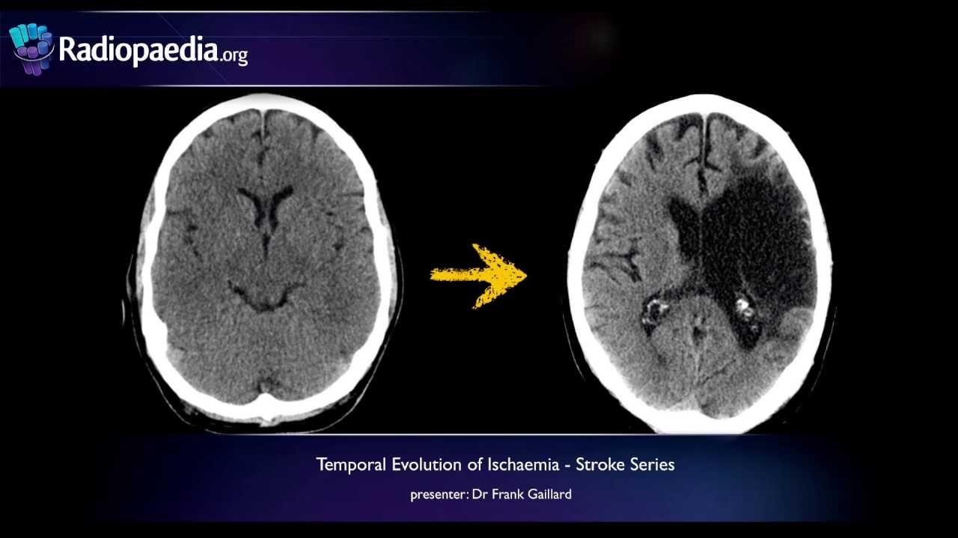
Objectives
The primary objective of the project is to:
Accurately classify medical images as stroke-positive or stroke-negative.
Differentiate between ischemic and hemorrhagic stroke’s.
Leverage state-of-the-art architectures to improve the accuracy and computational efficiency of stroke prediction.
Provide explainable AI (XAI) insights using Grad-CAM or SHAP for stroke identification, aiding medical practitioners in decision-making.

Slide 7
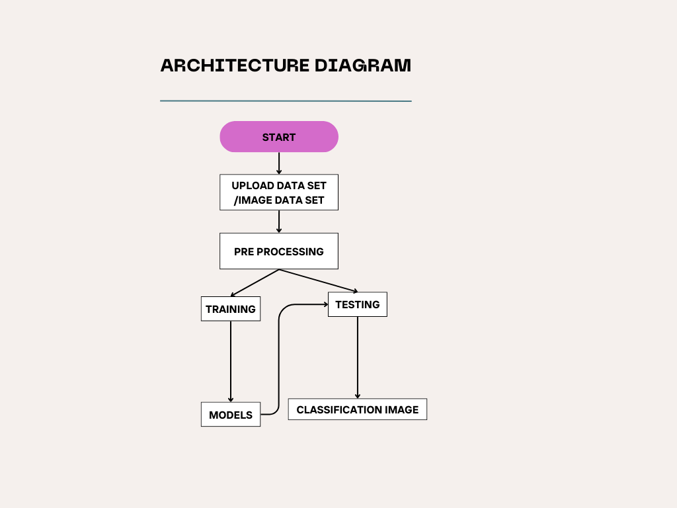
THE ARCHITECTURE DIAGRAM FOR BRAIN STROKE PREDICTION

Slide 8
Methodology
Data Collection and Preprocessing Data Source:
Utilize public stroke datasets like ISLES, RSNA Intracranial Hemorrhage Dataset, or proprietary clinical data
from hospitals.
Preprocessing:
Resizing, normalization, or intensity standardization of medical images.
Data augmentation techniques (rotations, translations, flips) to increase dataset diversity.
Noise reduction (e.g., Gaussian smoothing) to enhance image quality.
Skull stripping and segmentation to remove non-brain regions.
2. Model Architecture UNet/2D CNN for Segmentation:
Train a UNet or 2 CNN to segment brain regions from raw CT/MRI images, identifying areas affected by a
stroke.
The segmented output serves as an input for subsequent classification models.
Pre-trained Networks for Classification:
Use ResNet, VGG16/19, EfficientNet, DenseNet as feature extractors.
Pre-trained weights on ImageNet could be fine-tuned for the stroke prediction task.
Explore EfficientNet for optimized resource efficiency with high accuracy.
DenseNet for deeper feature propagation and improved classification accuracy.
Transformer Models:
Incorporate transformer-based models, such as Vision Transformers (ViT), for capturing long-range
dependencies and context in the image, especially useful in complex patterns of stroke lesions.

Slide 9
Cont…
3. Model Training and Optimization Loss Function:
Use a combination of Dice loss (for segmentation) and binary cross-entropy or categorical cross-entropy
(for classification).
Optimizer: Adam or SGD optimizers with learning rate decay.
Evaluation Metrics:
Accuracy, F1-score, AUC-ROC for classification.
Dice coefficient, Jaccard index for segmentation.
4. Post-Processing and Prediction
Refine the predictions using Grad-CAM or SHAP to visualize areas of importance.
Generate final predictions and assess performance on an unseen test dataset.
5. Deployment and Validation
Deploy the model using Flask/Django in a clinical decision support system (CDSS).
Validate the model using real-world clinical data.

Slide 10
Timeline of Project
Phase | Tasks | Duration | Timeline
Research | Problem Understanding, Planning | 1 week | UPTO 12-Sep-2024
Data Preprocessing | Data Collection, EDA | 3 weeks | UPTO 18-OCT-2024
Model Development | Image Processing,Modeling | 2 weeks | UPTO 9-NOV-2024
Training & Eval | Model Training, Validation | 2 weeks | UPTO 30-NOV-2024
Web Dev | UI, Backend, Model Integration | 2 weeks | UPTO 17-DEC-2024
Deployment | Cloud Infra, Model Deployment | 1 week | UPTO 24-DEC-2024
Testing | UAT, Feedback, Optimization | 1 week | UPTO 10-JAN-2025
Maintenance | Ongoing System Updates, Security | Ongoing | UPTO 17-JAN-2025

Slide 11
Expected Outcomes
High Accuracy in Stroke Detection
Weather stroke is present or not

Slide 12
Conclusion
This advanced brain stroke prediction system combines state-of-the-art deep learning models like UNet, ResNet, EfficientNet, and Transformer models to accurately detect and classify strokes from medical imaging data. By employing segmentation and feature extraction techniques, it identifies stroke-affected brain regions and differentiates between ischemic and hemorrhagic strokes. Rigorous preprocessing, model fine-tuning, and data augmentation enhance its performance. The use of explainable AI tools like Grad-CAM ensures interpretability, making the model reliable for clinical use. Once deployed, the system can support timely and accurate stroke diagnosis, ultimately improving patient outcomes and aiding medical professionals in critical decision-making.

Slide 13
References
IEEE Transactions on Medical Imaging: A leading journal in the field of medical image analysis.
IEEE Journal of Biomedical and Health Informatics: Focuses on the intersection of biomedical engineering and informatics.
IEEE Transactions on Biomedical Engineering: Covers a wide range of topics in biomedical engineering, including medical imaging and signal processing.
IEEE International Conference on Engineering in Medicine and Biology (EMBC): A major annual conference in the field of biomedical engineering.
IEEE Conference on Computer Vision and Pattern Recognition (CVPR): A top-tier conference for computer vision research, including medical image analysis.
Automatic Neuroimage Processing and Analysis in Stroke—A Systematic Review
Current approaches and advances in the imaging of stroke
Neuroimaging and deep learning for brain stroke detection - A review of recent advancements and future prospects
A Review on Computer Aided Diagnosis of Acute Brain Stroke
Automatic brain ischemic stroke segmentation with deep learning: A review

Slide 14
Thank You

